Slide 1
Talk & Play #011 Lets talk about (volume) shaders
Julian Oberbeck
Technical Artist
julianoberbeck@gmail.com
technicalArtist.de

Slide 2

Julian Oberbeck
Technical Artist
julianoberbeck@gmail.com

Slide 3
What you can take away from this presentation
Super simple introductory knowledge about rendering, raymarching and how shaders work in Unity
A simple yet effective trick to make procedural textures tileable
Understand how Worley / Cell noise works
How you can make volume / 3D textures
See an MRT Scan of Mario

Slide 4
Some Theory
Example 1: Something neat and noisy to look at
Example 2: Write a raymarching shader

Slide 5
What is a shader?

Slide 6
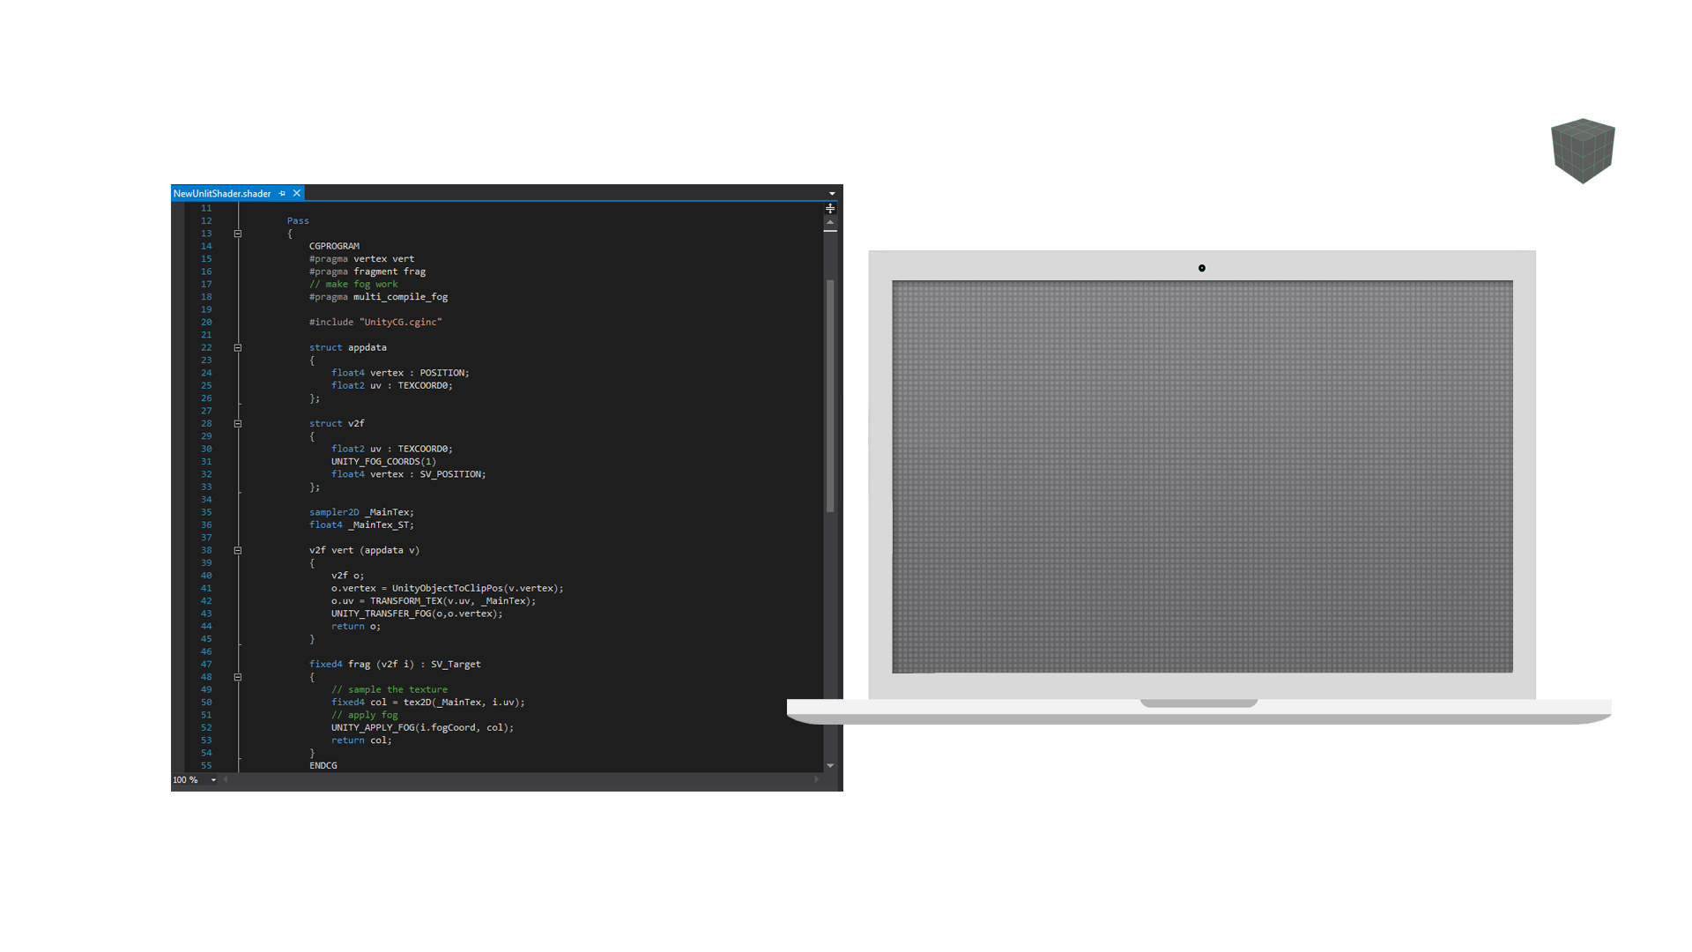

Slide 7
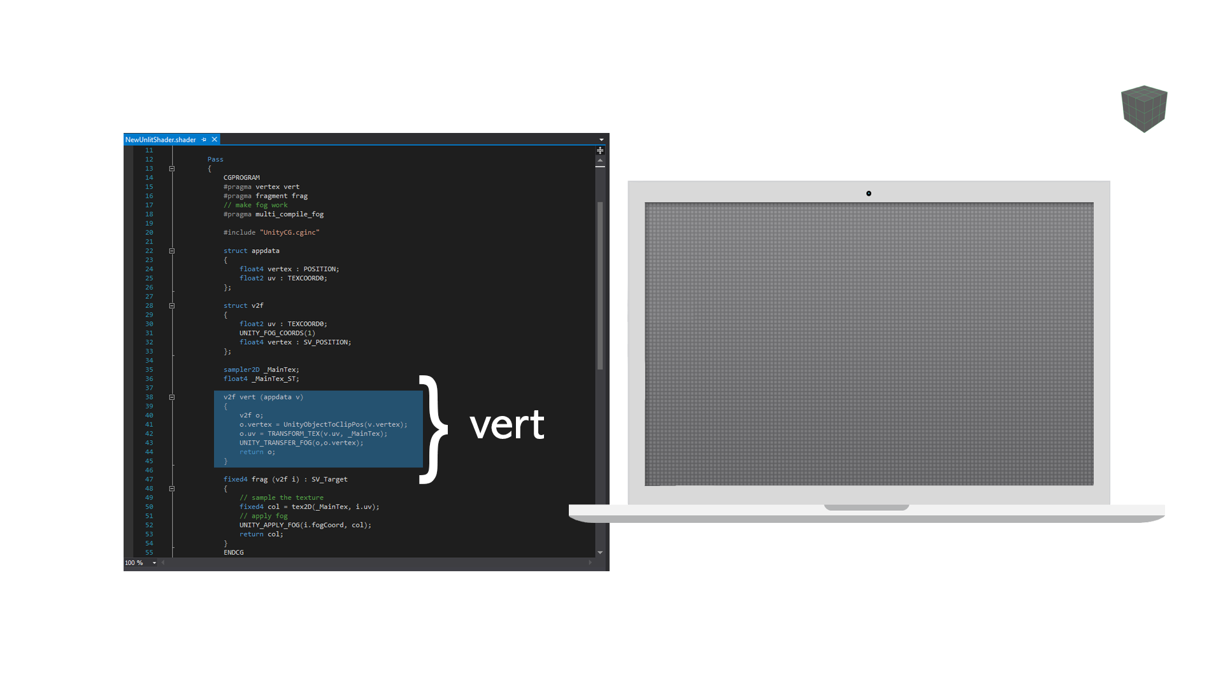

Slide 8
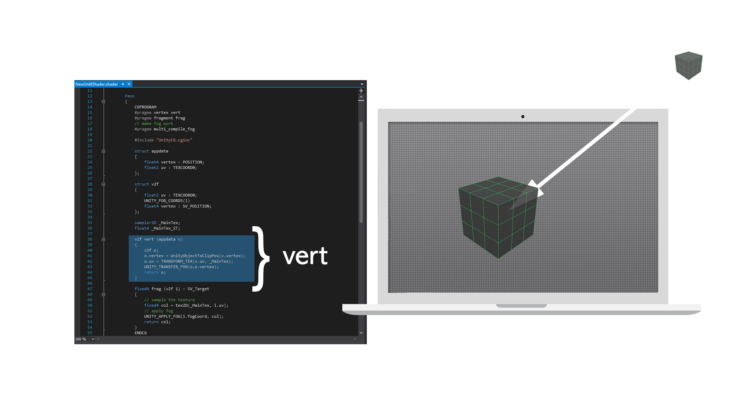

Slide 9
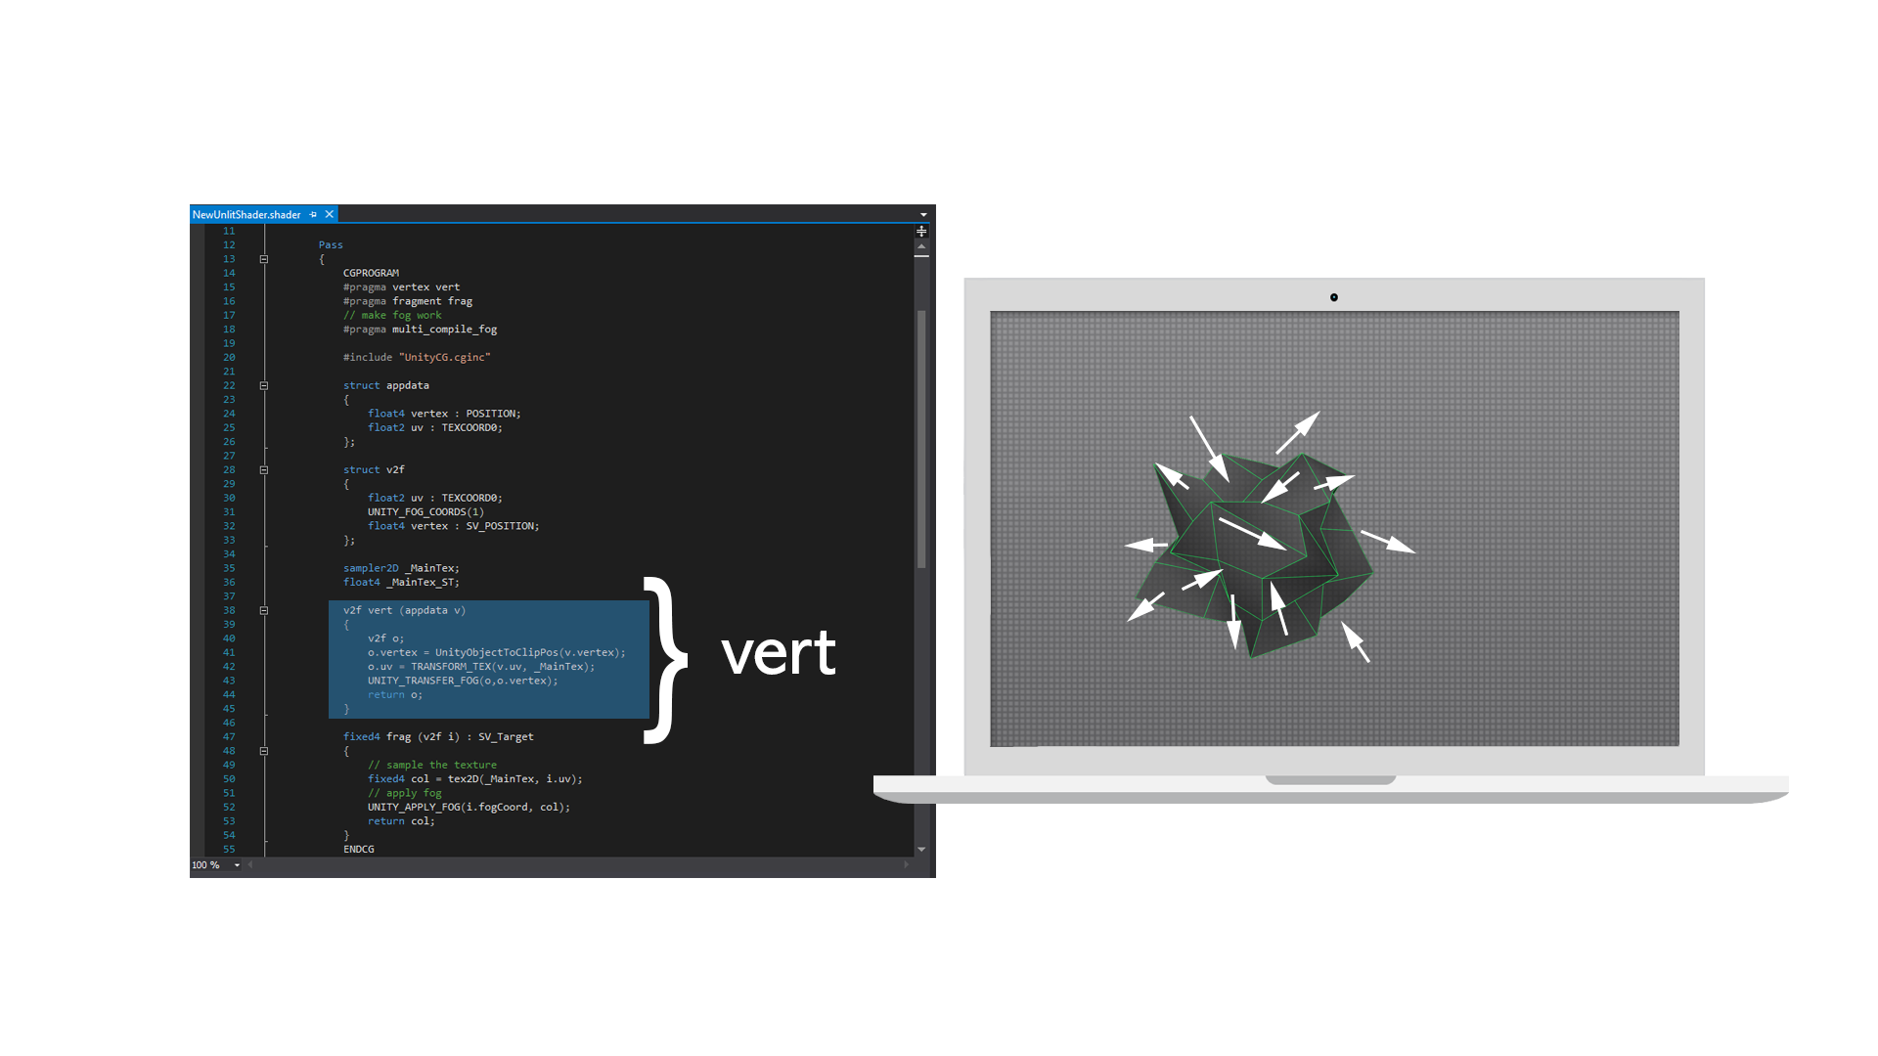

Slide 10
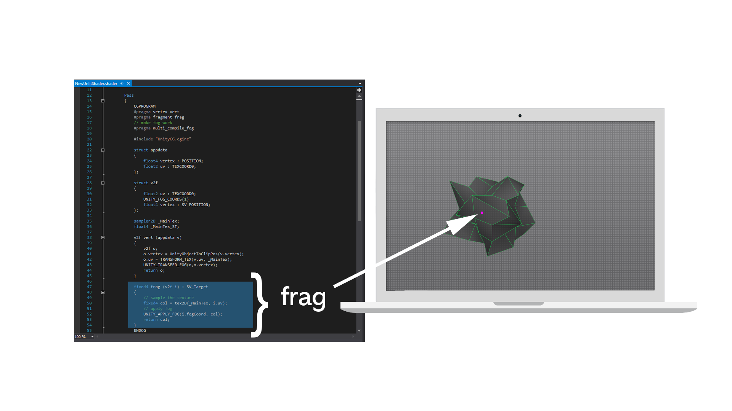

Slide 11
Rendering Surfaces & Volumes

Slide 12
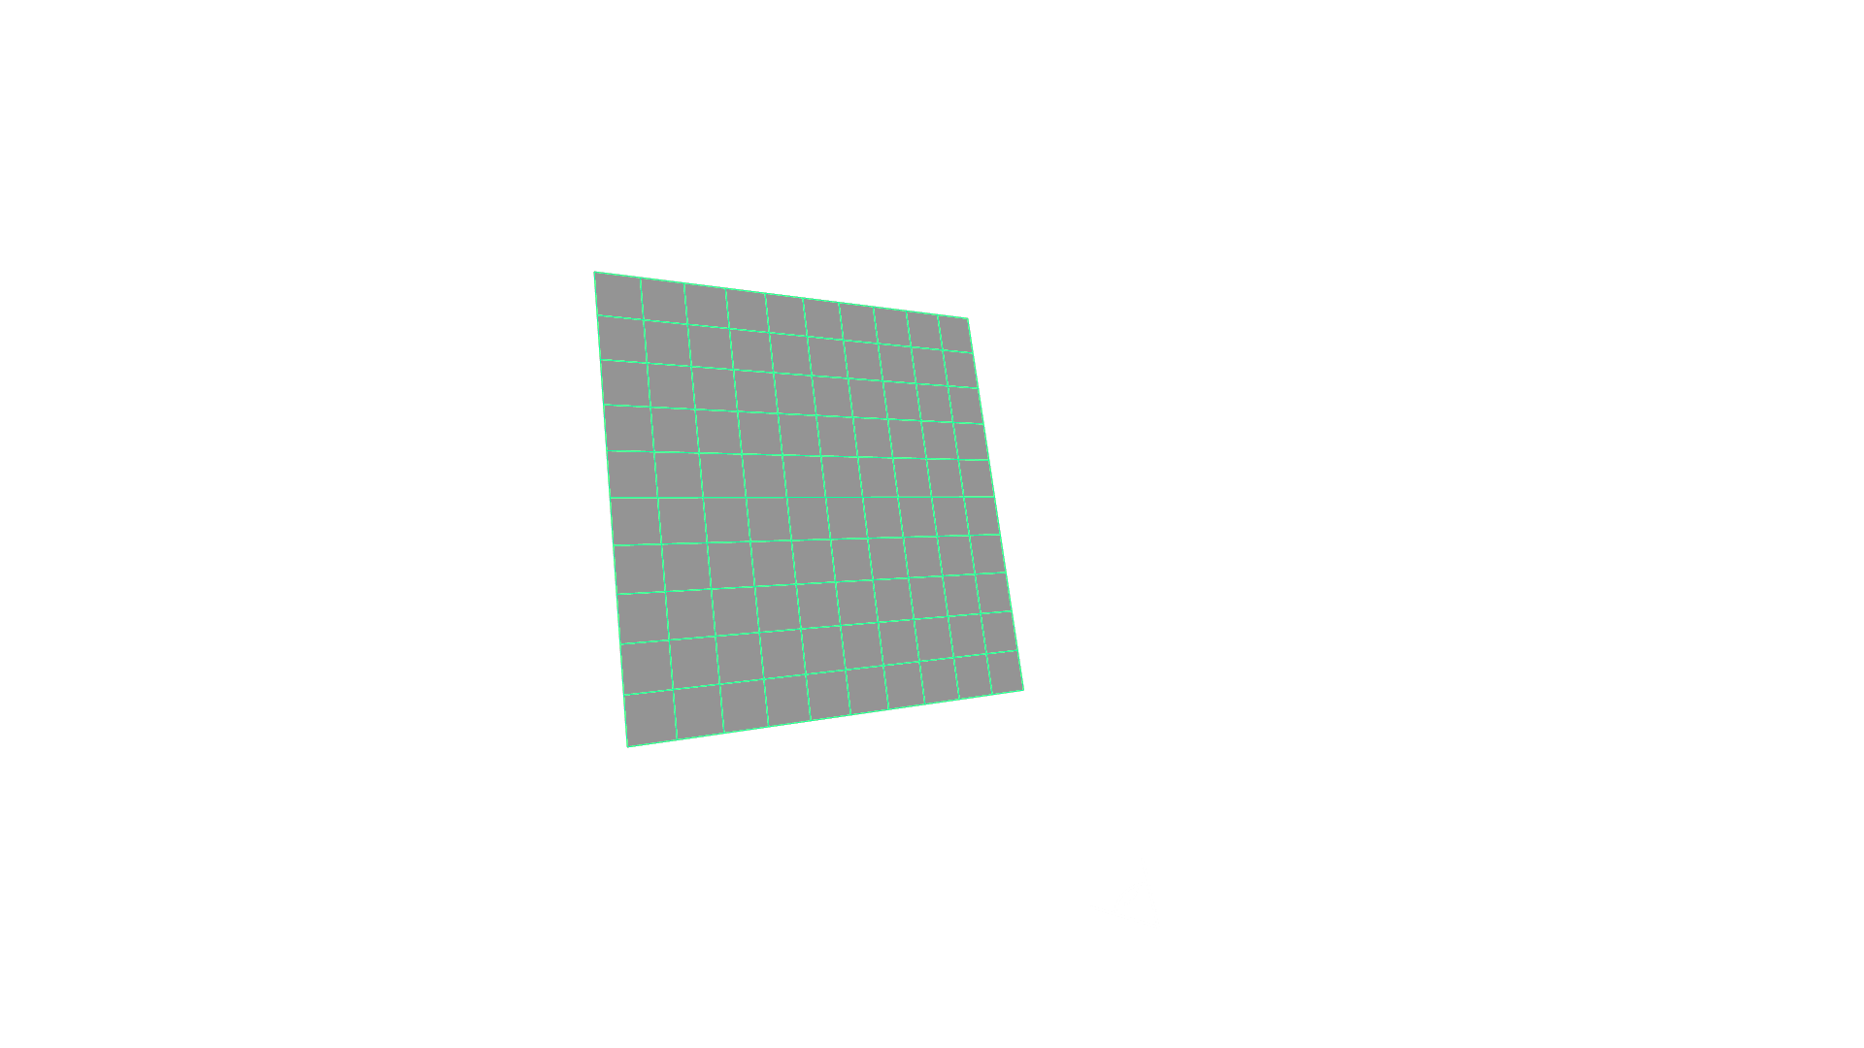


Slide 13
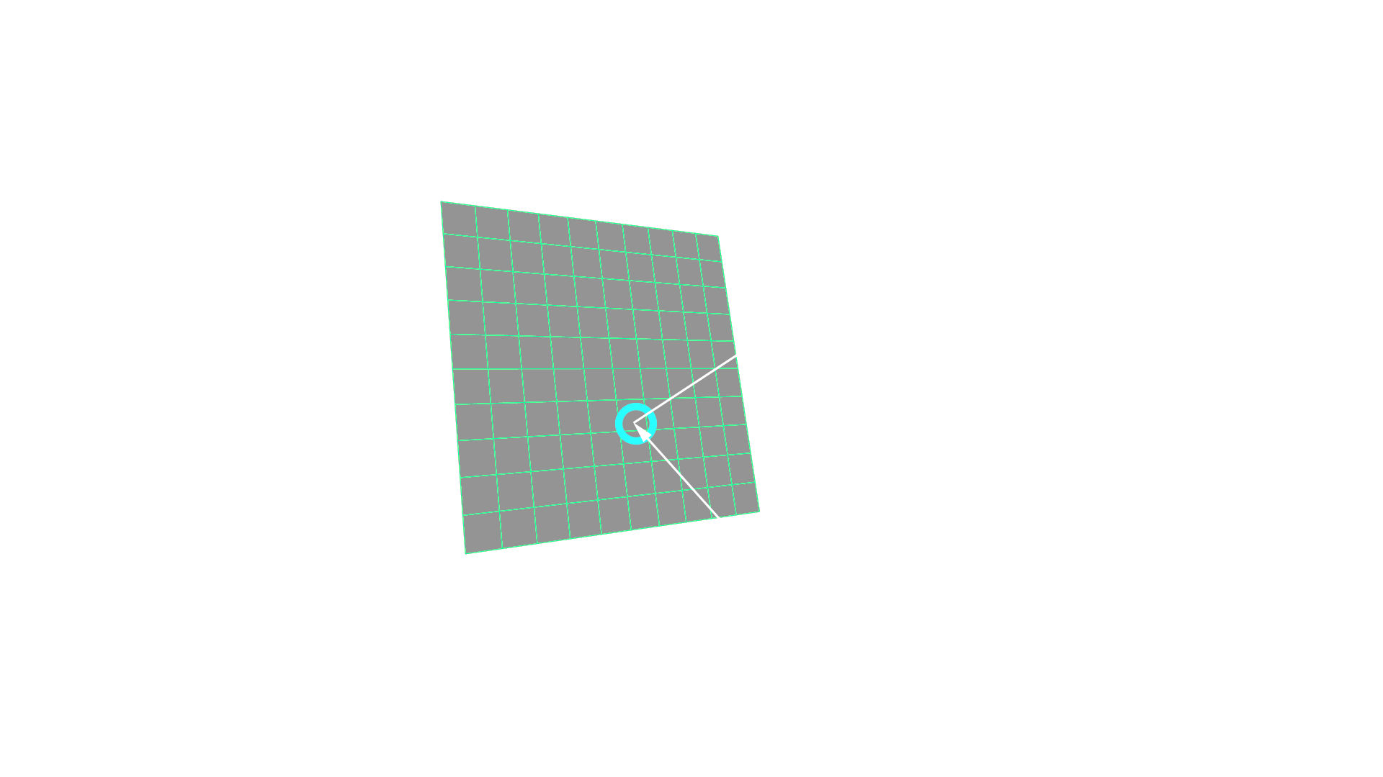

Slide 14
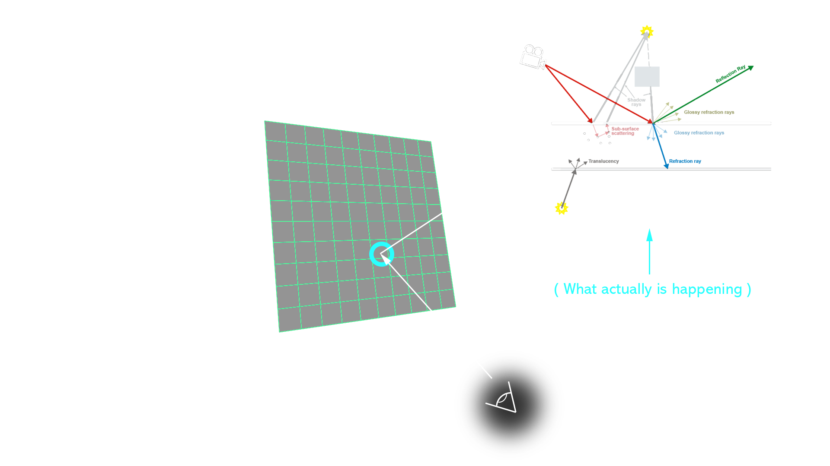

Slide 15


Slide 16


Slide 17
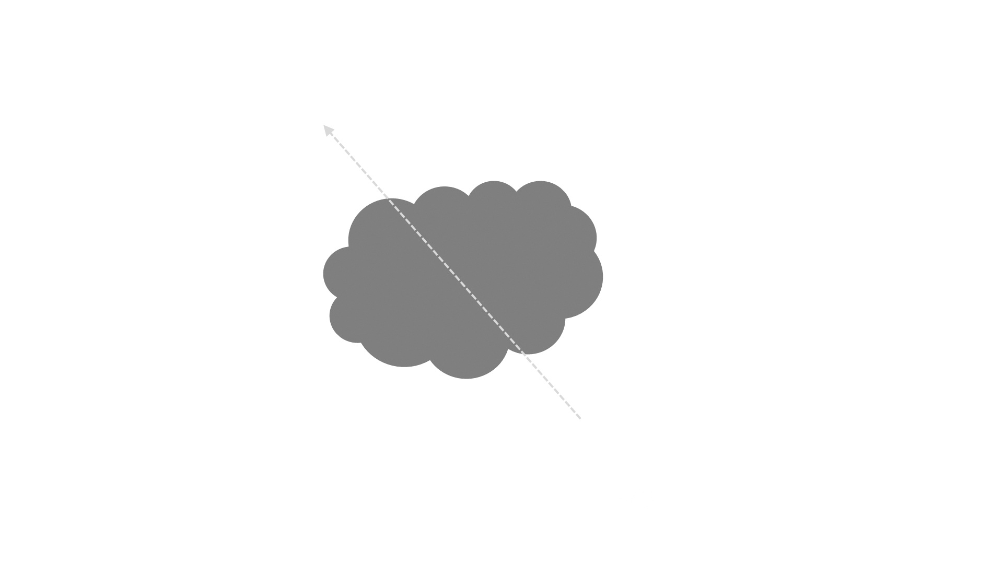

Slide 18
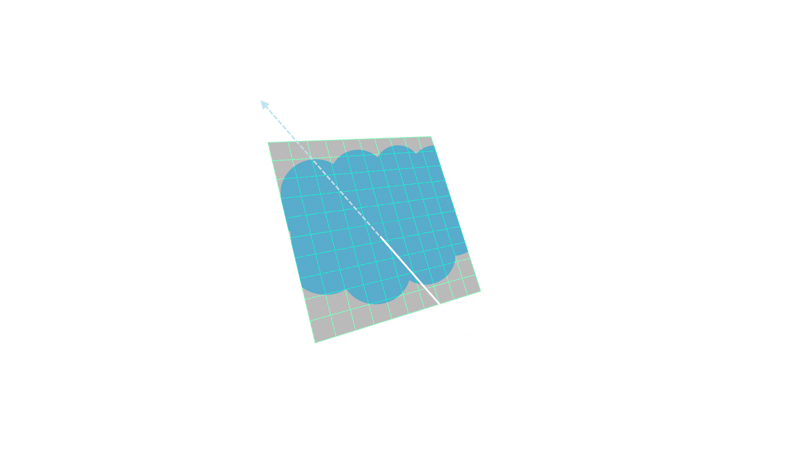

Slide 19
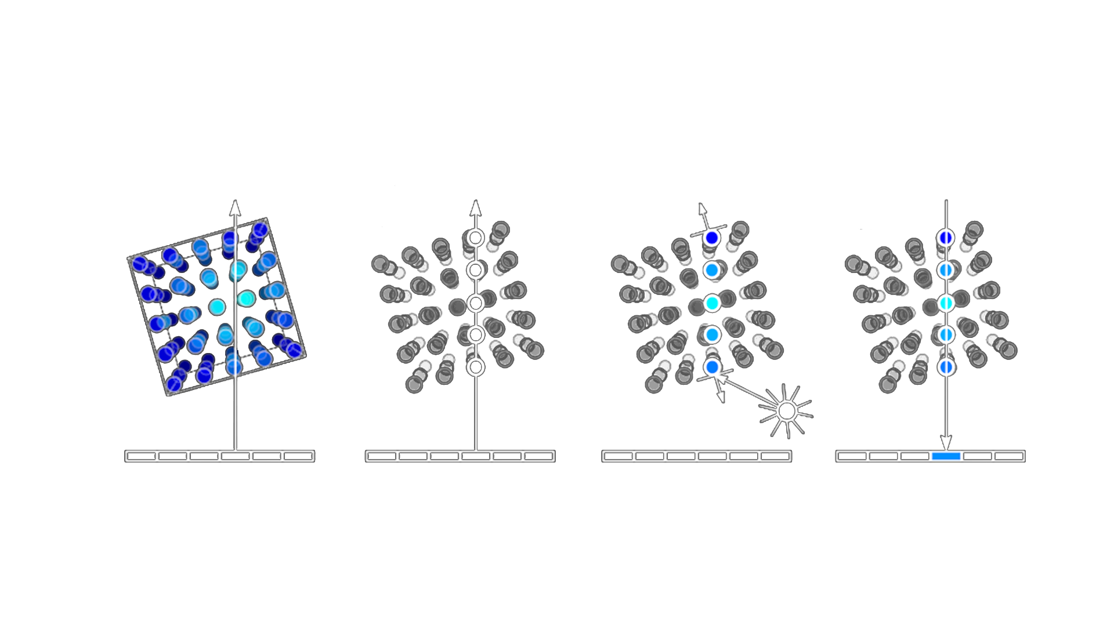
Raymarching

Slide 20
But what to put into our volume shader?
Procedurally shading Worldspace
3D Volume Textures

Slide 21
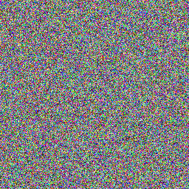

Slide 22
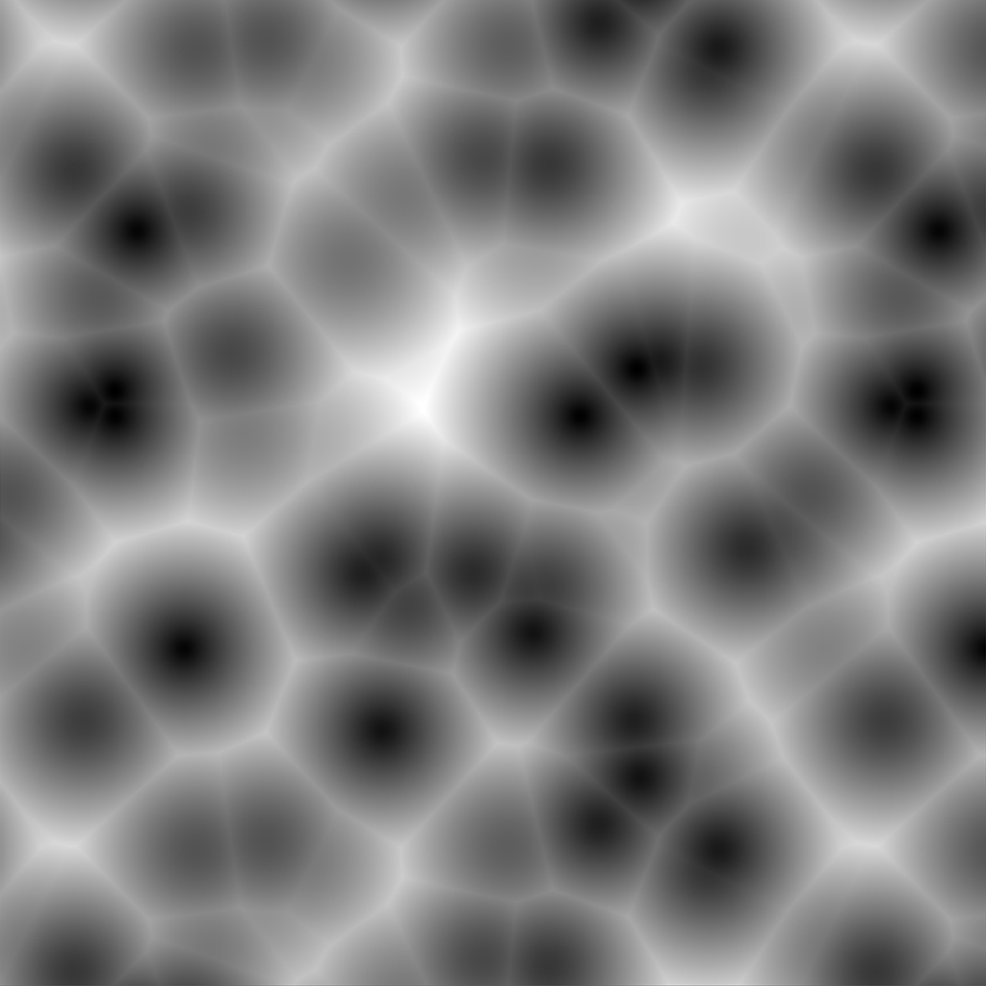

Slide 23
Worley / Cell Noise
Minimum distance between scattered points
Black pixels are close to a point
White pixels are very far away from every point

Slide 24
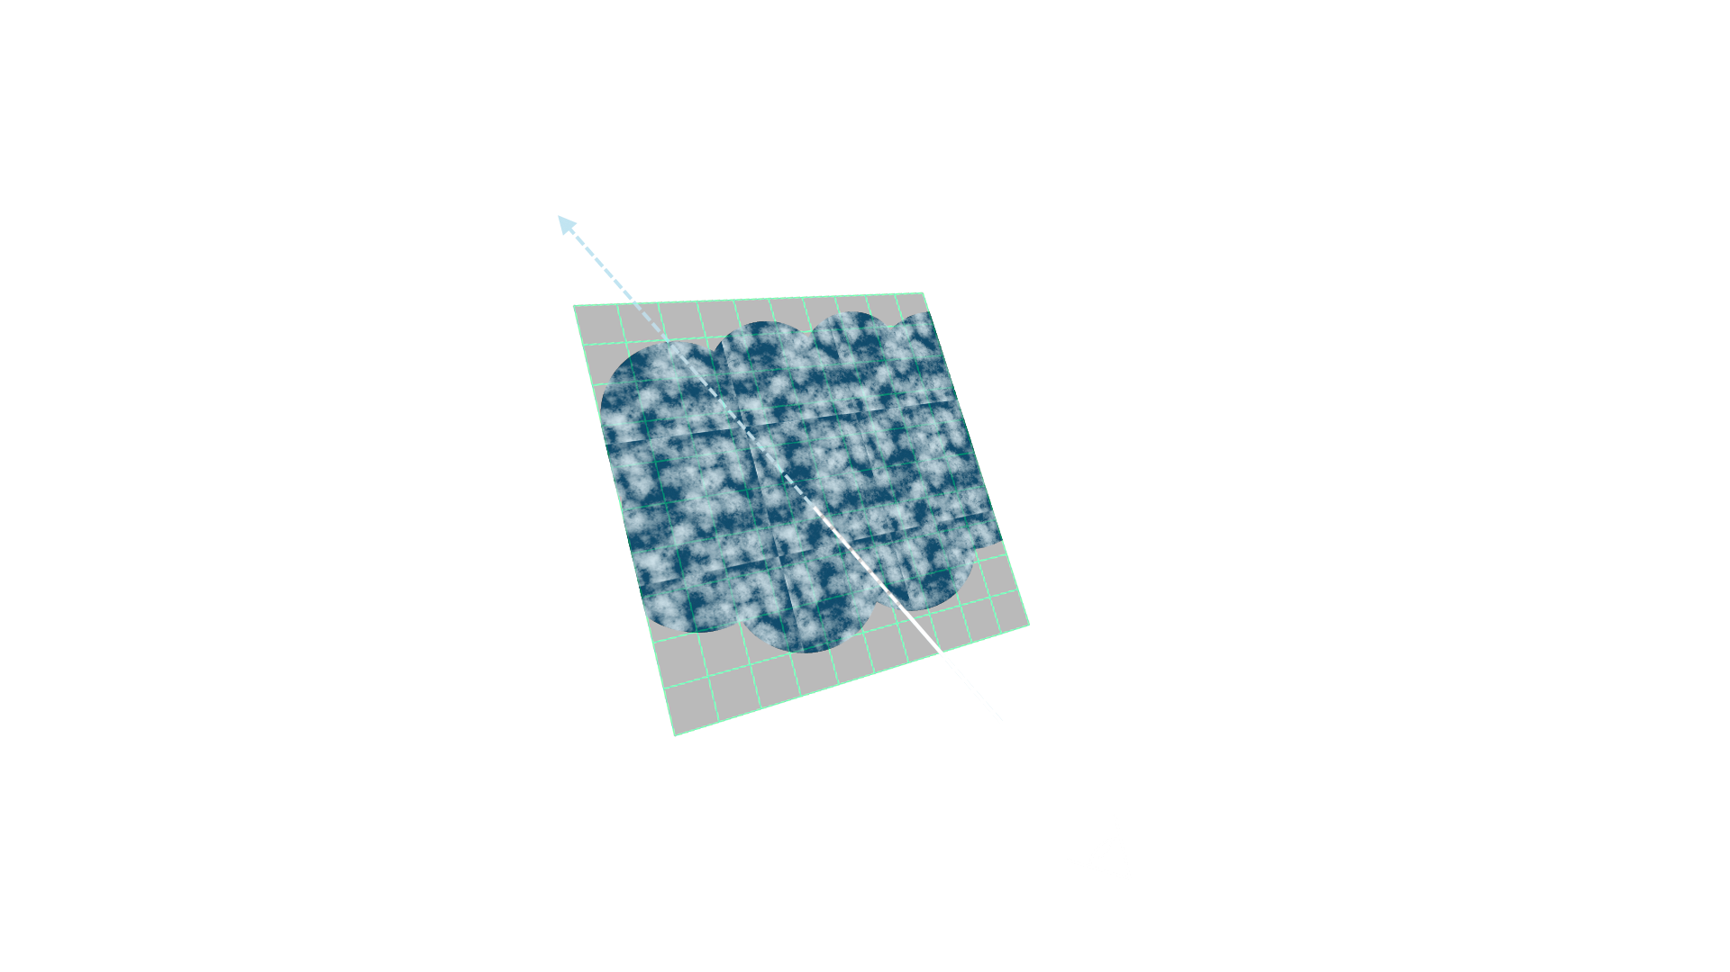

Slide 25


Slide 27
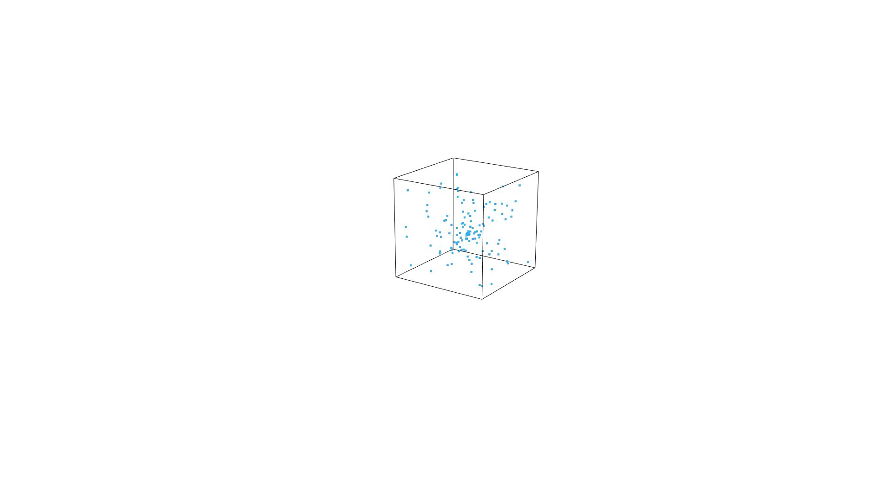

Slide 28


Slide 29
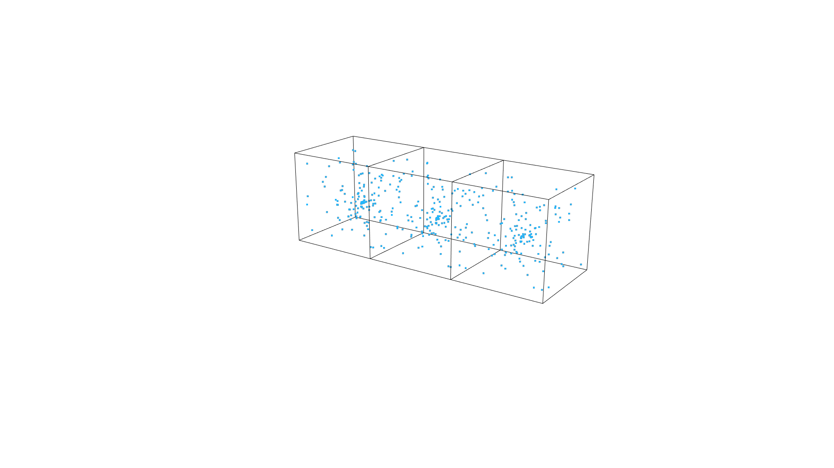

Slide 30
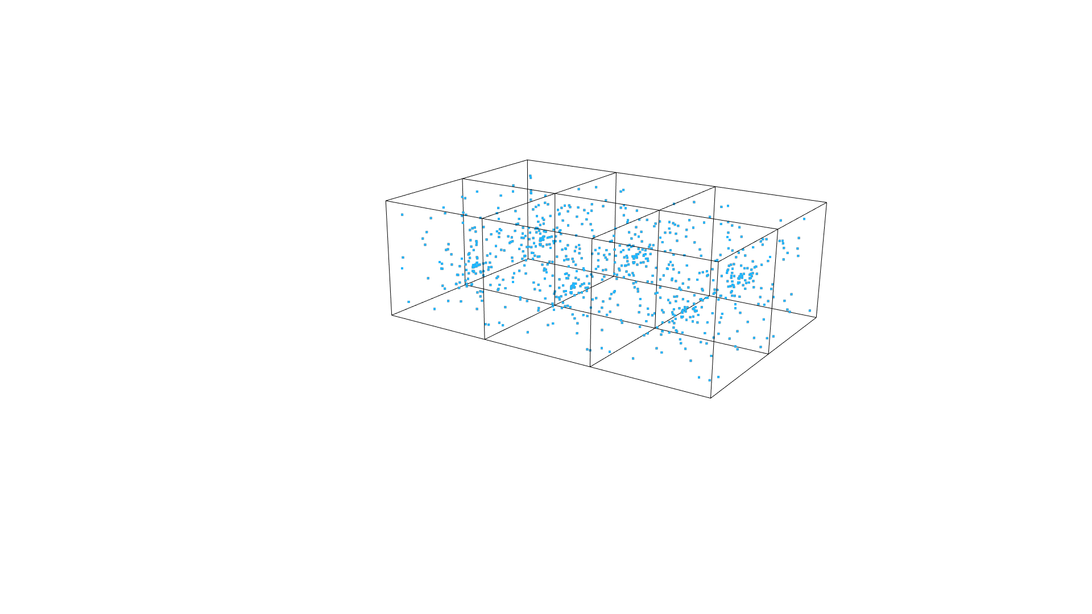

Slide 31
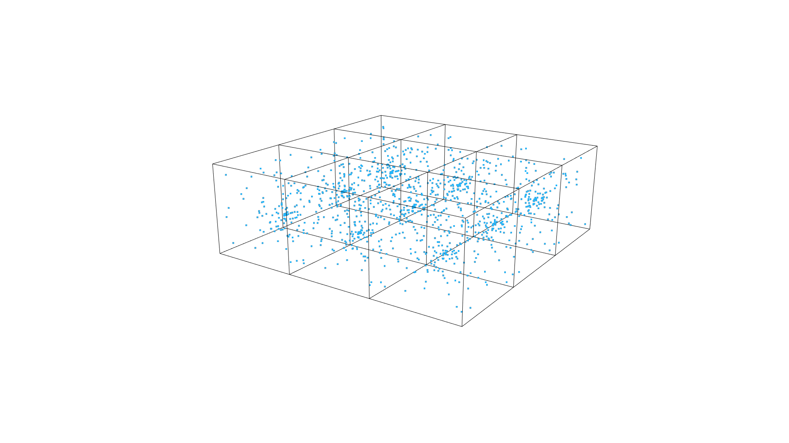

Slide 32
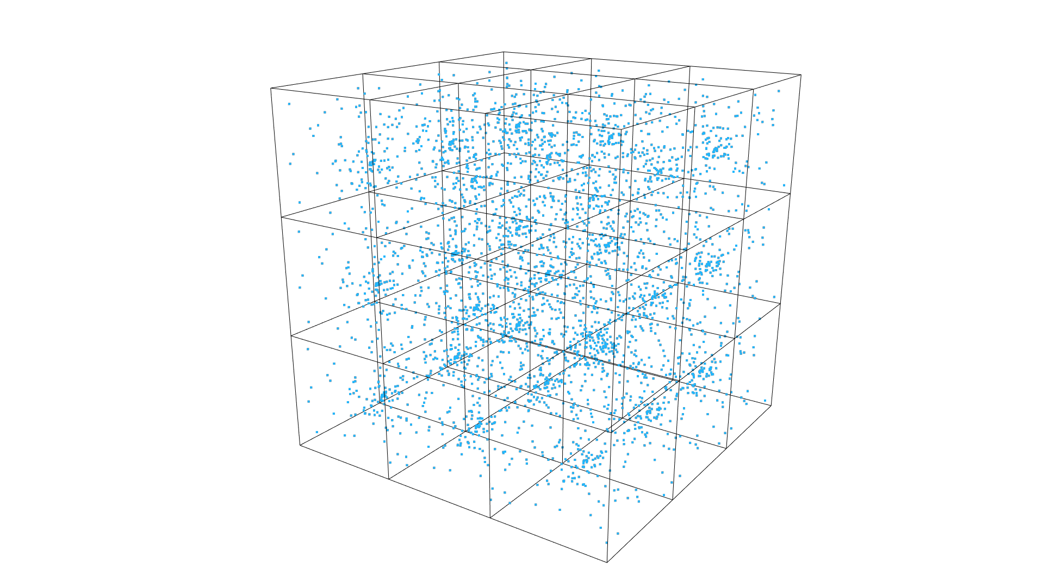

Slide 33
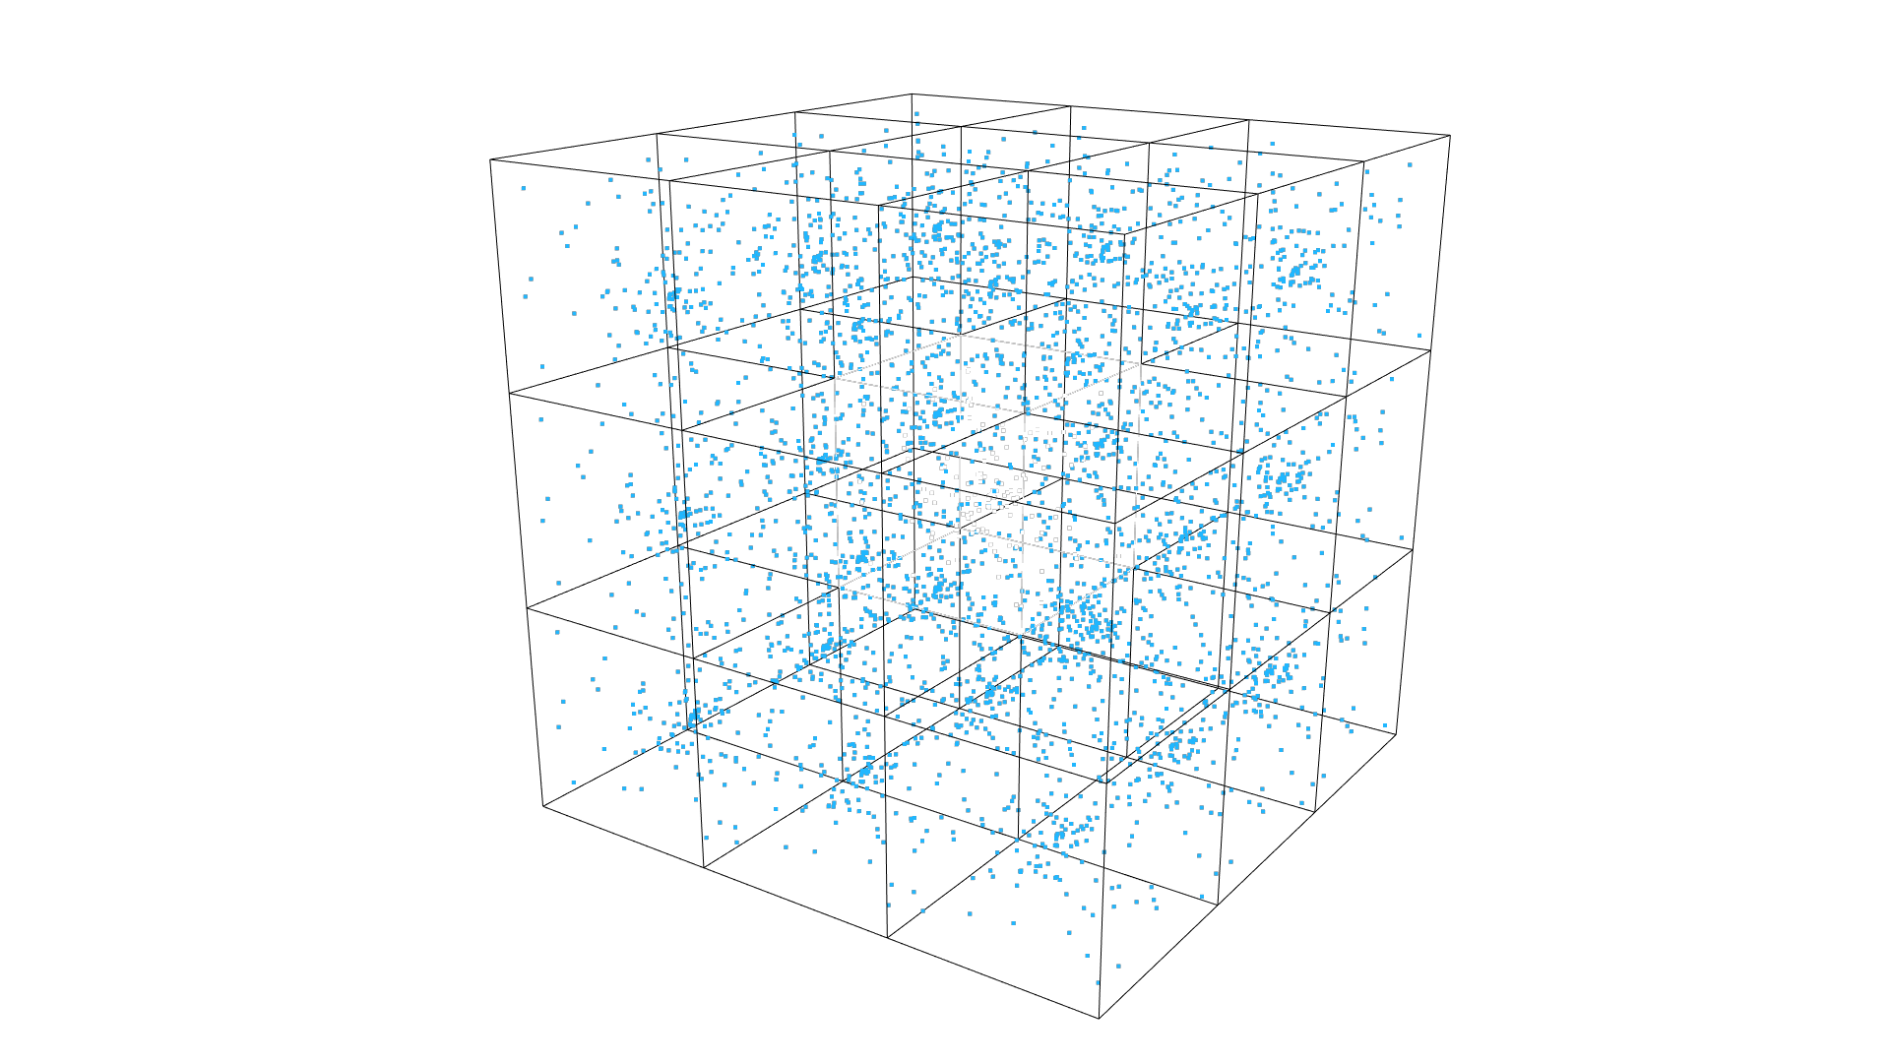

Slide 34
Example 1: Voronoi Shader

Slide 35
Example 2: Raymarching Volumes

Slide 36
Some more resources:
http://www.alanzucconi.com
http://www.shadertoy.com

Slide 37
Talk & Play #011 (Volume) Shaders
Thanks For Your Attention
Any Questions?
Julian Oberbeck
Technical Artist
julianoberbeck@gmail.com
technicalArtist.de

